Slide 1
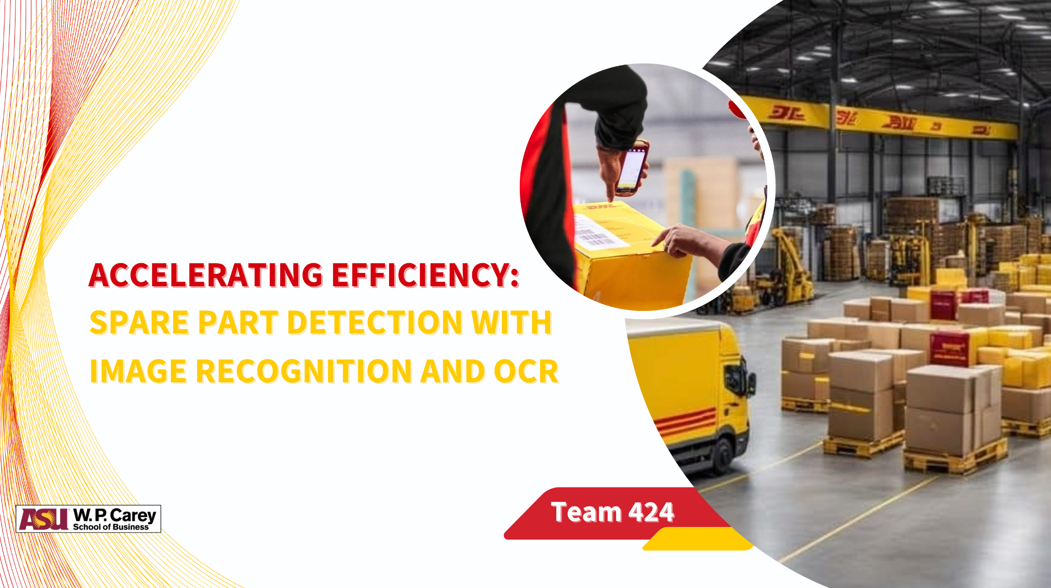

Slide 2
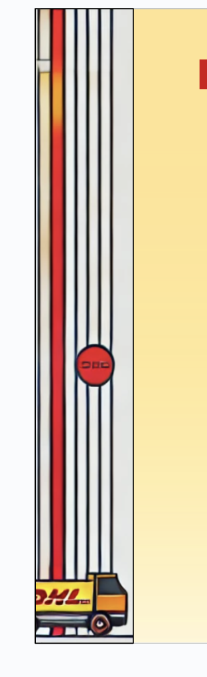
WHAT’S HAPPENING AT DHL?
Due to inefficiencies in spare part detection methods,
15,574 hours are lost annually
Across 200 warehouses in North America
So,
How can we reclaim this lost time?

Slide 3
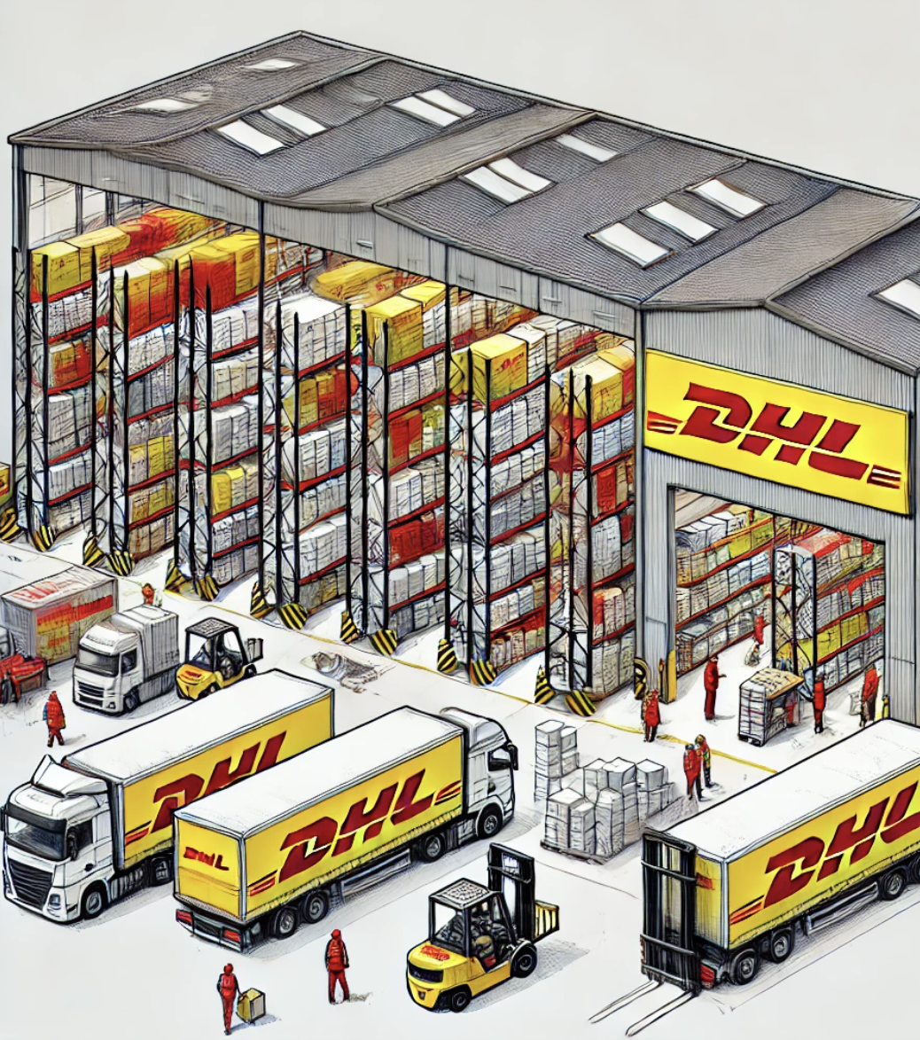
RECAP - Interim presentation

Slide 4

Objectives
Problem Statement
Unlabeled/Labeled spare parts returned to DHL Logistics warehouses cause delays and inefficiencies:
Operators rely on manual identification, often requiring customer confirmation.
Field Engineers lack the infrastructure to properly label or package parts.
Impact:
Increased processing time and operational inefficiency.
Higher costs for customers due to delayed visibility and potential new purchases.
Automate Part Identification
Develop a model to recognize part numbers from photos and detect any anomalies or damages.
Enhance Inventory Visibility
and Accuracy
Improve real-time stock updates by integrating part recognition with the part master file and online searches.
Minimize Customer and Operational Costs
Lower costs by reducing delays and avoiding unnecessary new purchases through faster identification.
Reduce Processing Time
Accelerate the receiving process by automating part identification and metadata capture.

Slide 5
Data Acquisition
Data Preparation
Model Development
Model Training
Obtained initial dataset from DHL.
Developed comprehensive project plan
Held discussions with the client to decide on requirements.
Created a dataset of 1,000+ images using Augmentor.
Annotated images for training, testing and validation.
Created a part master file manually to link parts with their complementary data.
Researched similar use cases to identify applicable methods and models.
Developed base OCR and image recognition models.
Decided on YOLOv8 and Google Cloud Vision API
Determined the optimal number of epochs for training
Addressing limitations in the OCR model.
Refining project plan based on findings and progress updates.
Integration
Cost Estimation
Model Deployment
Integrating the mage recognition and OCR models into a unified solution.
Cost Analysis associated with implementing solution.
Cost comparison of solution with old process.
Prepared documentation of all the progress and limitations which might help in creating a deployment plan.

Slide 6
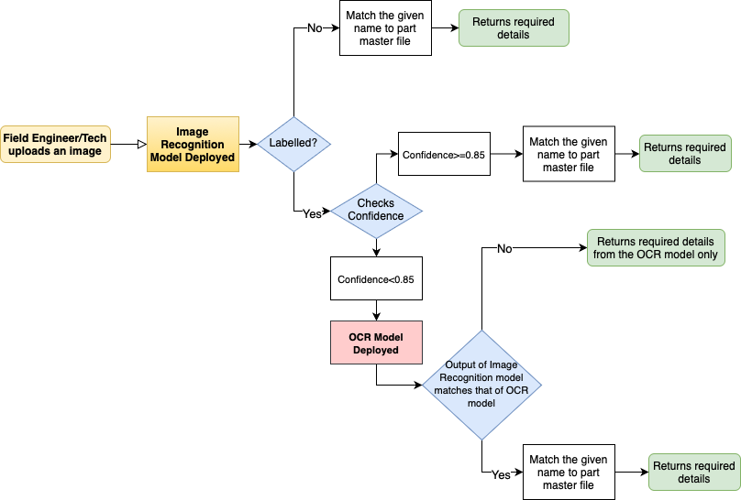
Yolov8 model
Google Cloud API

Slide 7
Costs
Savings
Development Costs
$232,000 - $533,000
Deployment Costs
$65,000 -$100,000
Labor Savings
$305,000 - $385,000
Downtime Reduction Savings
$500,000 -$650,000
Maintenance Costs
$90,000 - $190,000
Technology Upgrade
$500,000 - $850,000
Error reduction & Rework savings
$700,000 - $925,000
Eg: Development Costs
Image collection: $72,000 to $110,000.
Augmentation: $ 6,250 - $ 7,500
Labeling/Annotation: $ 100,000 - $ 350,000
Storage costs: $1,500 to $3,000.
Model Training: $52,500 to $62,500 dollars.
Eg: Labor savings:
With 1 min saved per part
2000-2500 parts received across 28 warehouses,
for 200 warehouses - 12,379 to 15473 hrs/yr saved.
At $25 wage rate : total savings per year -
$ 300,000 to $380,000
Assumptions:
10,000 parts in total
25 images per part to be taken
Pay - $ 35/hour
Storage: 5-10 TB data
Cloud hosting for model deployment
App/upgrade to app for using model on mobile
API costs – Link
Maintenance is usually 10% of upfront costs, but assume 20% new parts each year
Took 30% of upfront costs
2 mobiles and 1 camera for each warehouse
Tech upgrade - $1500-$3000 per warehouse (assumption from web)
Please refer to the detailed analysis here - Link

Slide 8
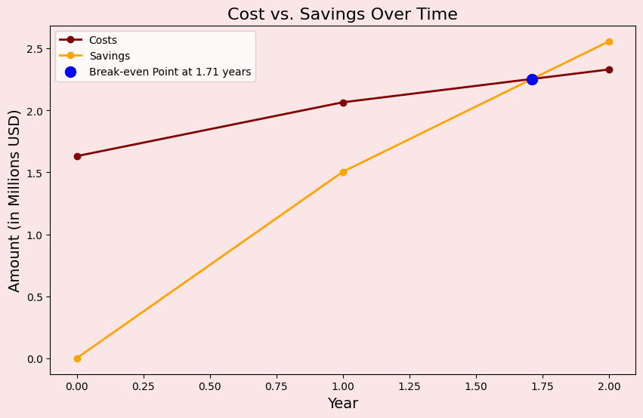
Break-even Analysis
*Based on Costs and Savings Assumptions

Slide 9
PROPOSED SOLUTION

Slide 10
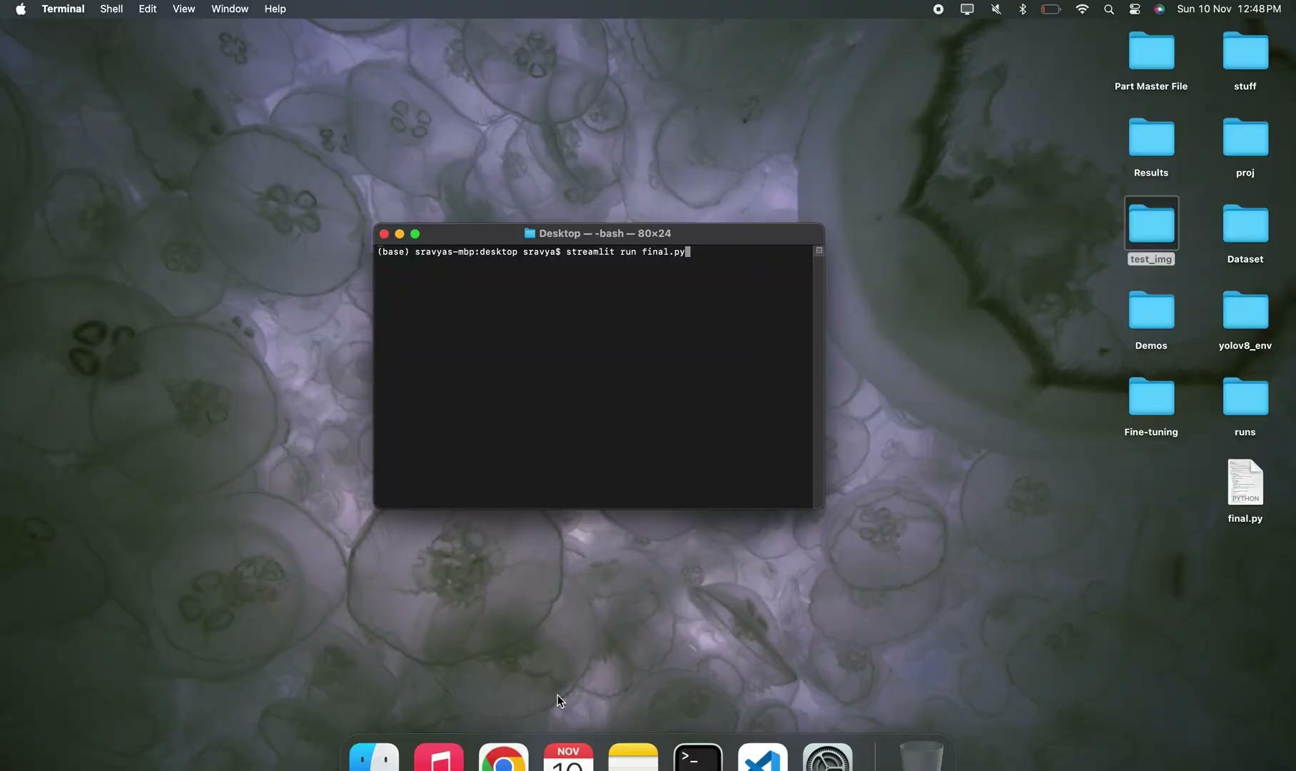
DEMO 1: How the image recognition works with RAM

Slide 11
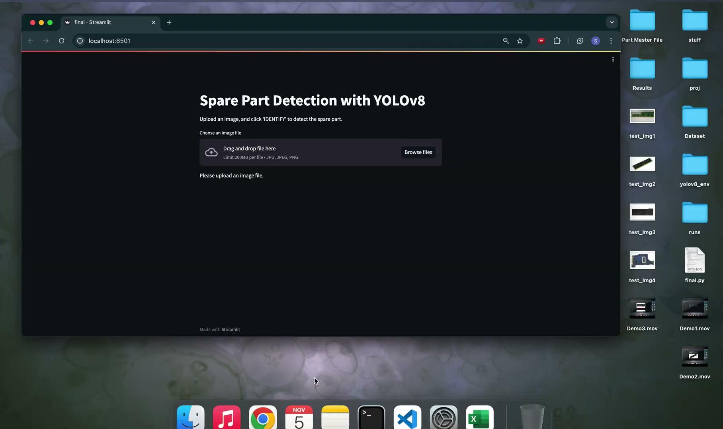
DEMO 2 - how the image recognition part works with Motherboard
Notes:
how the image recognition part works with Motherboard

Slide 12
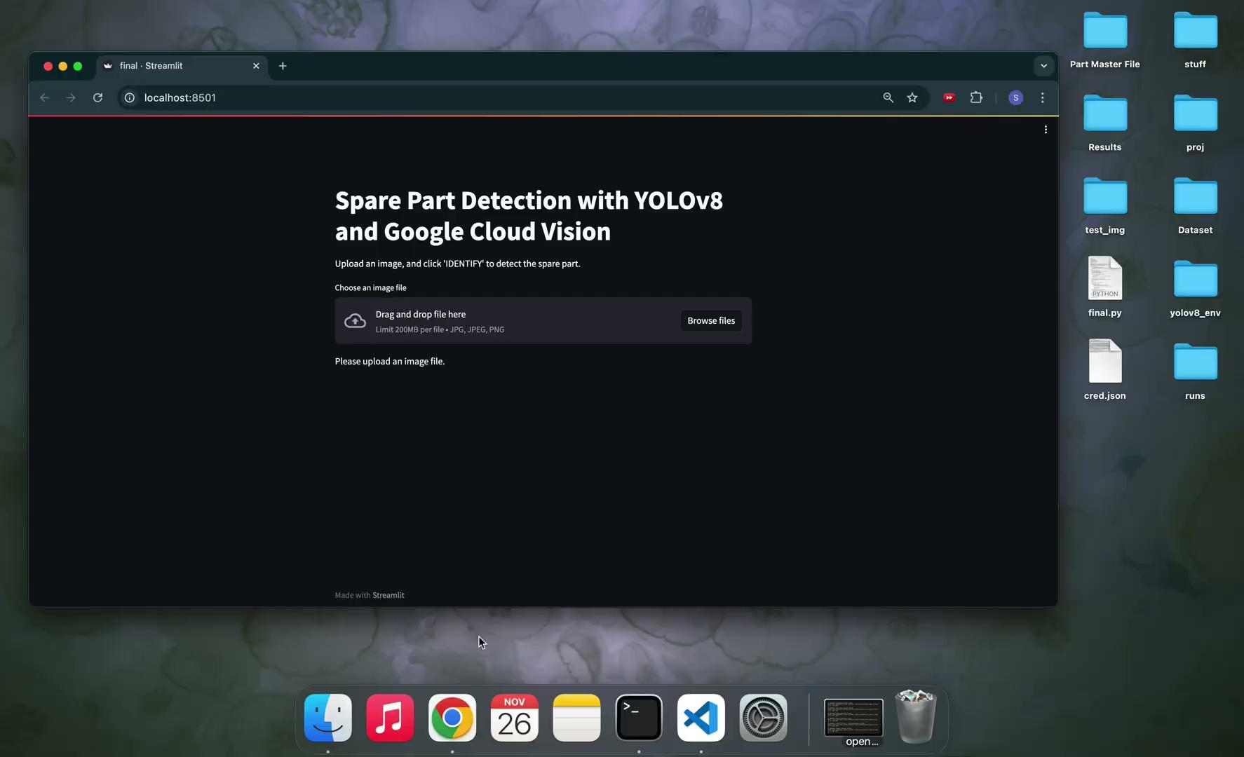
DEMO 3 - How the fallback model (OCR) works
Notes:
how the image recognition part works with Motherboard

Slide 13
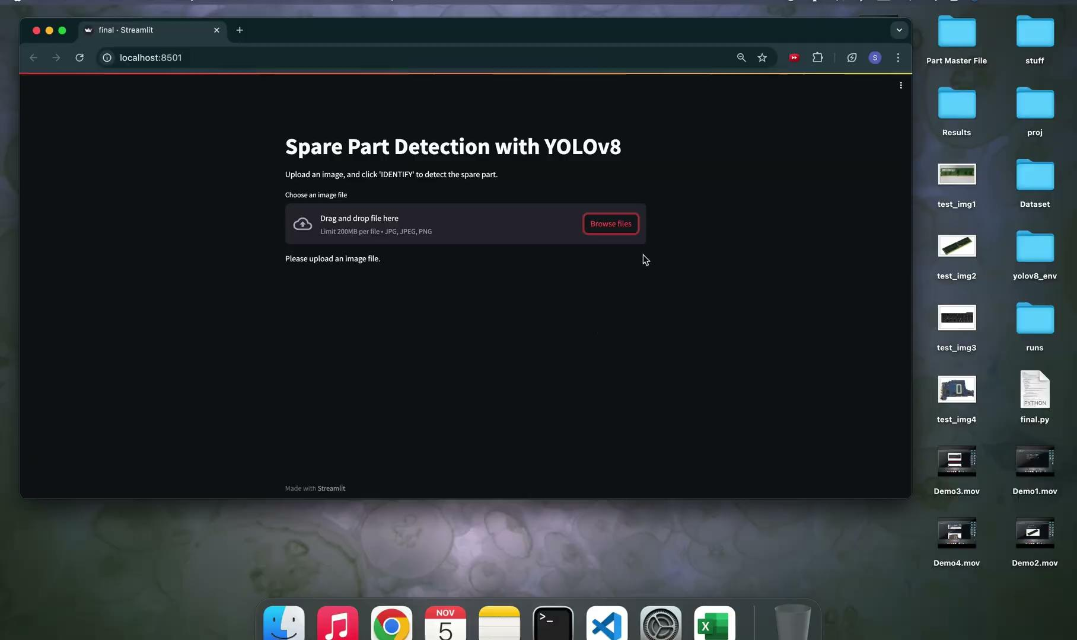
DEMO 4 - Demo of how the image recognition part works with an unknown image
Notes:
Demo of how the image recognition part works with an unknown image

Slide 14
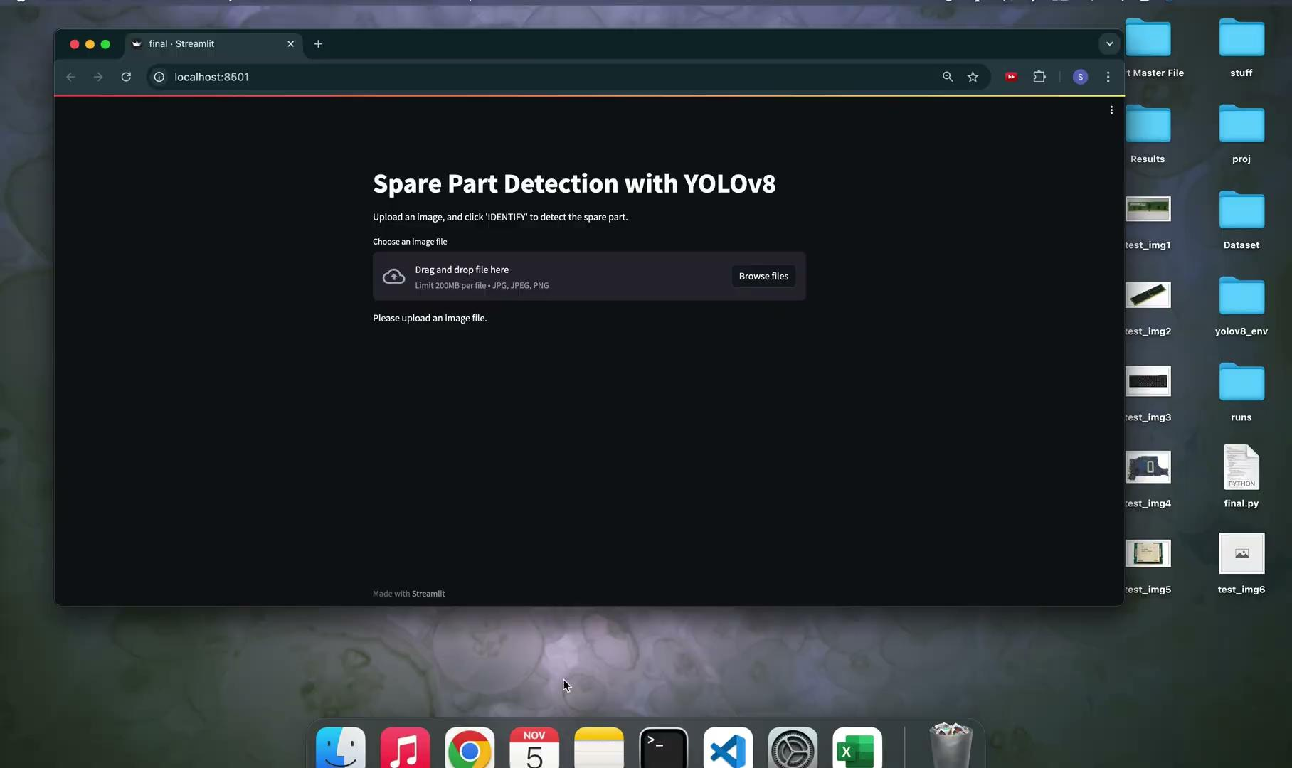
DEMO 5 - Demo of error handling (Blank images)
Notes:
Demo of error handling (Blank images)

Slide 15
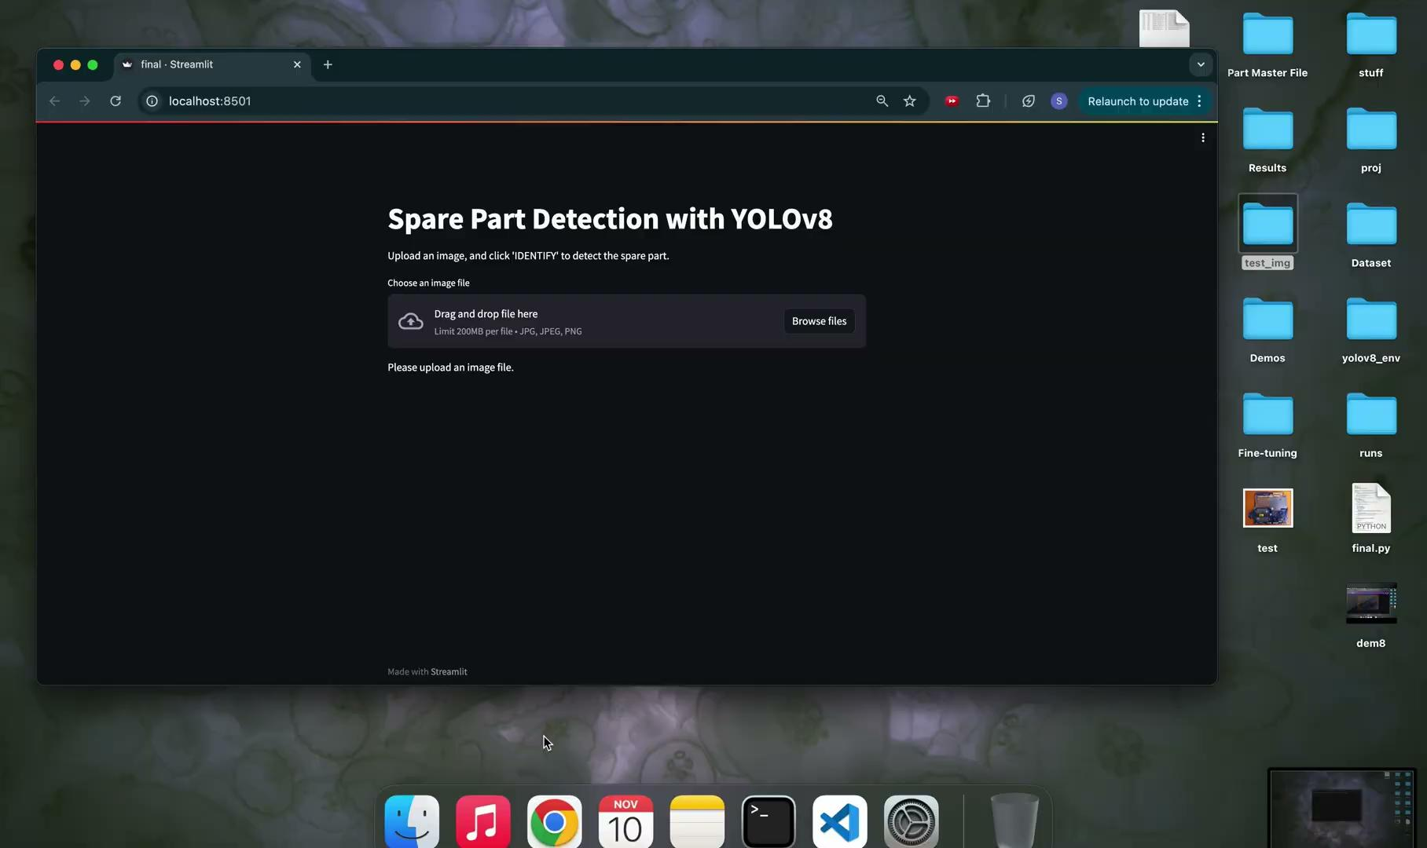
DEMO 6 - Demo of error handling (Part master file missing / Wrong file type)
Notes:
Demo of error handling (Part master file missing / Wrong file type)

Slide 16
HOW DOES OUR PROPOSED SOLUTION WORK?
The image recognition of our model works using a yolov8, trained on 30 epochs, with minimal hyper parameter tuning.
So,
How did we choose this approach?

Slide 17
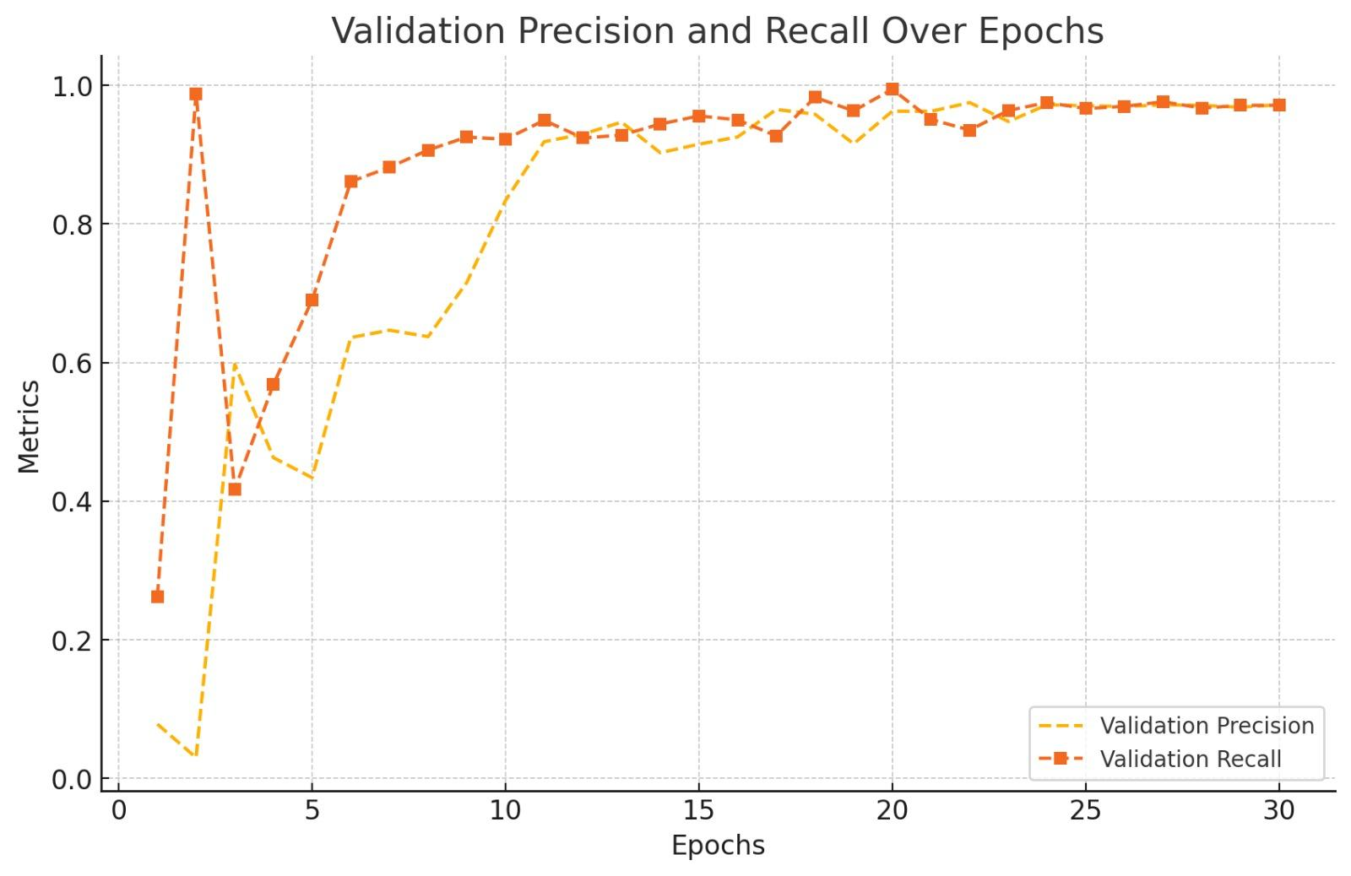
Step 1: Identifying the Ideal Epoch Range
To do so, we implemented “EARLY STOPPING”.
This technique monitors the model's performance on unseen data (Validation Set) during training.
If the performance plateaus and shows no improvement over several iterations, the training process is halted.

Slide 18
Step 2: Linking Key Performance Indicators
The key performance indicators chosen are as follows:
Precision: How accurate the model is when it says, "This is RAM."
Recall: How well the model catches all instances of RAM or motherboards.
mAP50: Combines precision and recall into one overall performance score, considering IoU ≥ 50%. (IoU measures how much the predicted box overlaps with the actual box.)
Epochs | Precision | Recall | mAP50
25 | 0.315 | 0.369 | 0.348
30 | 0.622 | 0.687 | 0.746
35 | 0.222 | 0.347 | 0.259
140 | 0.502 | 0.326 | 0.443
150 | 0.503 | 0.397 | 0.486
Patience | Ideal Epoch
5 | 35
10 | 140
15 | 150
Taking that into consideration that our IDEAL EPOCH could be 30!

Slide 19
Step 3: Further Fine tuning
We decided to aim for a high mAP50 value, therefore we introduced:
Lr (Learning Rate):
The speed at which the model learns patterns and features from the data.
If too high, the model might skip over important details, failing to learn effectively.
If too low, the model may focus on unnecessary features and overfit.
Lrf (Learning rate factor):
A multiplier that adjusts the learning rate dynamically during training.
It helps control how quickly or slowly the learning rate changes over time.
Parameters | Precision | Recall | mAP50
lr0=0.001, lrf=0.1, epoch=30 | 0.236 | 0.424 | 0.309
lr0=0.001, lrf=0.15, epoch=30 | 0.249 | 0.401 | 0.337
lr0=0.001, lrf=0.2, epoch = 30 | 0.305 | 0.498 | 0.372
Parameters | Precision | Recall | mAP50
lr0=0.005, lrf=0.1, epoch=30 | 0.236 | 0.424 | 0.309
lr0=0.005, lrf=0.15, epoch=30 | 0.249 | 0.401 | 0.337
lr0=0.005, lrf=0.2, epoch=30 | 0.305 | 0.498 | 0.372
We first tried changing the LRF (Learning Rate Factor), but caused a DROP in our performance metrics, and when we tried increased the learning rate (LR),it had no effect. THIS SHOWS FINE TUNING HAD NEGATIVE IMPACT ON PERFORMANCE.

Slide 20
HOW DOES OUR PROPOSED SOLUTION WORK?
For OCR (text recognition) we used Google Vision API
So,
How did we choose this approach?

Slide 21
OCR models:
Due to several limitations in Tesseract, we considered other options
Google Translate vs Google vision API
#images/total | Google Translate | Google Vision API | Description
18/50 | 100% | 100% | Normal tag
4/50 | 100% | 100% | Upside down tag
1/50 | 98% | 99% | Normal tag
10/50 | (10-30%) Avg: 16% | (10-30%) Avg: 17% | No Tag
10/50 | (10-23%) Avg: 17% | (10-24%) Avg: 17% | No main label
5/50 | (5-12%) Avg: 9% | (8-14%) Avg: 12% | Tag/label not clearly visible
2/50 | 0 & 7% | 0 & 5% | Main Label present but majorly cut out
1/40 | 20% | 40% | Distant label
Both models perform well and almost similarly - Google Vision API gave slightly better results in this case

Slide 22





TECHNOLOGIES USED IN OUR PROPOSED SOLUTION
Used for building and training the image recognition models.
Used for image annotation; helping to label parts for training, validation, and testing.
OCR capabilities for reading text/labels on parts, assisting in identification
Used for data processing, augmentation and model development.
Used for image preprocessing

Slide 23
Limitations
Solutions/Recommendations
Dataset size and Image Augmentation issues with GAN - Could generate only low resolution images or expensive
Image Augmentation performed using Augmentor - High resolution and Cheap
OCR and Label recognition difficulties - with Tesseract - misidentifying characters & struggling with rotated or zoomed-out text
Google Vision API for OCR - works much better than tesseract for text recognition
Part label matching issues - parts did not consistently match the entries in the provided part master file
Created part master file using information from Google by searching the parts manually
Annotation and Dataset Organization - Annotating the augmented dataset was labor-intensive and time consuming
Pro versions for Annotations would decrease workload and time
Uncertainty in Images and Labels -not all parts would have labels and background of images were not consistent
Consistent background should be used for all the images - White background would be the best option going forward.

Slide 24
Questions?
Thank You
Links to all files-
Code Files:
Documentation of all limitations and recommendations: Link
Further Implementation and SOP:
Cost and Savings Calculations: Link

